Slide 1
analysis of
streamflow frequency
using either
PeakFQ or HecSSP

Slide 2


first…
What has changed?

Slide 3
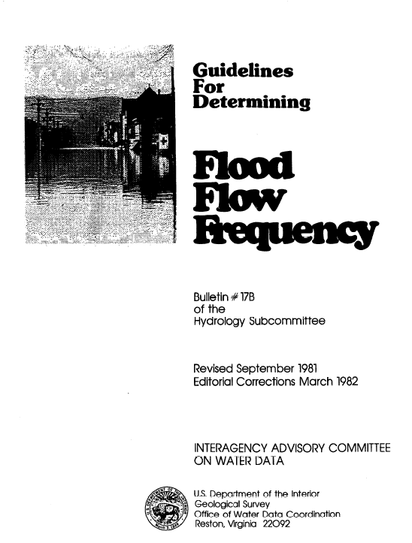
17B
1976

Slide 4
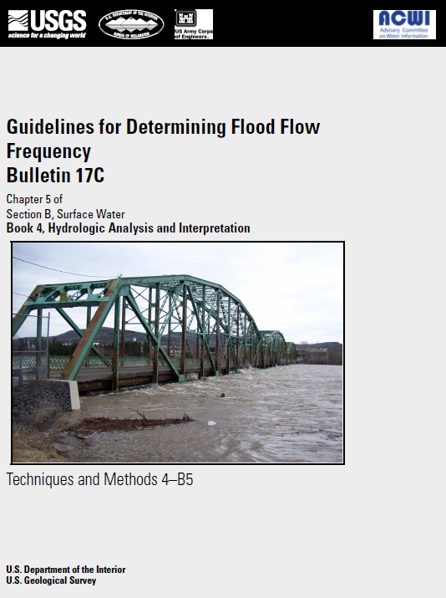
17C
2017

Slide 5
17B vs 17C
good guidance
standard for 41 yrs
includes:
confidence limits
outlier detection
historic floods
improves:
all of those
is now the new
professional standard

Slide 6
17B vs 17C
For more info…
See Bulletin 17B (page 27)
on recommended future studies.
See Bulletin 17C (page 3)
on the four fundamental improvements

Slide 7
Bulletin 17C
The four fundamental imrpovements…
The ability to include peak flood estimates that
gages have not precisely recorded, which may
consist of:
  a threshold estimate (“not higher than X”)
  an interval estimate (“between X and Y”)

Slide 8
Bulletin 17C
The four fundamental imrpovements…
Updated statistical capability
(Expected Moments Algorithm, EMA)
which computes any combination of
peak data types together
(Bulletin 17B adjusted for historic floods
or potentially influential low flows
as separate analyses.)

Slide 9
Bulletin 17C
The four fundamental imrpovements…
3) Updated confidence interval computation
(seamless accounting for non-systematic data)

Slide 10
Bulletin 17C
The four fundamental imrpovements…
4) Updated low-outlier flagging
(seamless, rather than multi-step as in 17B)

Slide 11
two programs upgraded
to 17C standards:
USGS: COE:
PeakFQ & HecSSP

Slide 12
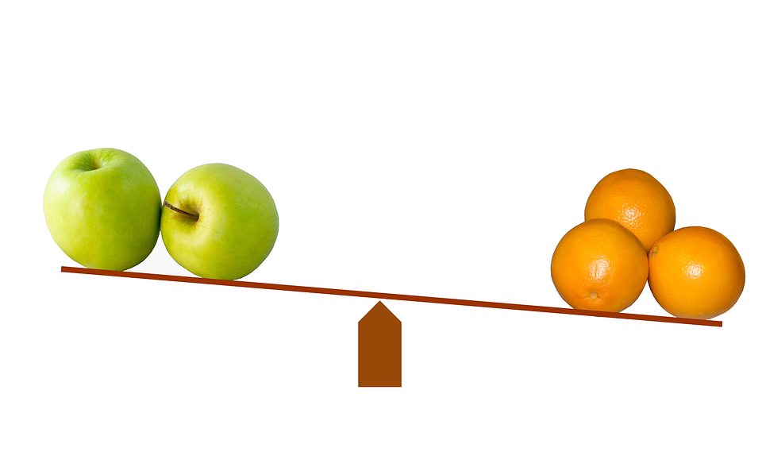
HecSSP ?
PeakFQ ?

Slide 13
We’ll cover both…

Slide 14
links…
PeakFQ:
https://water.usgs.gov/software/PeakFQ/
HecSSP:
http://www.hec.usace.army.mil/software/hec-ssp/
Bulletin 17C:
https://pubs.usgs.gov/tm/04/b05/tm4b5.pdf

Slide 15
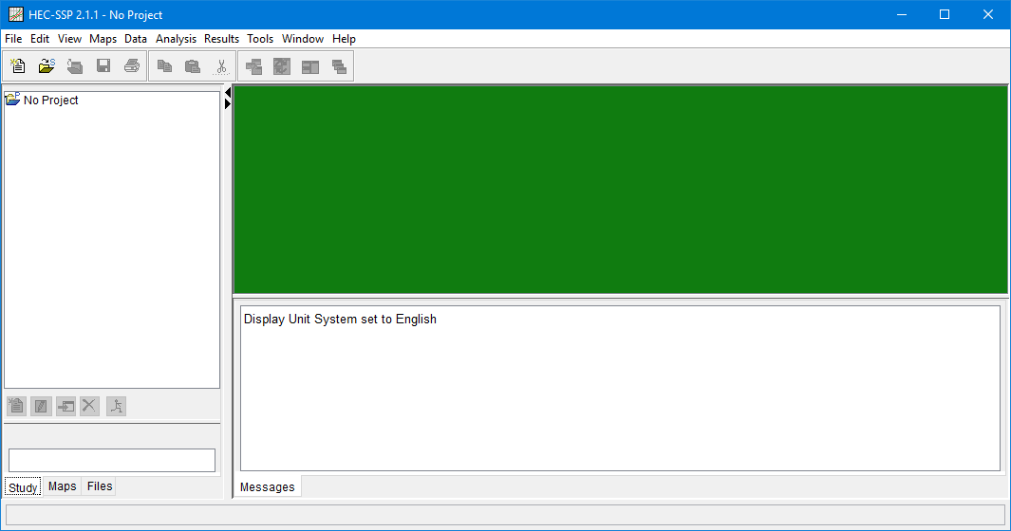
HecSSP
program main menu:

Slide 16
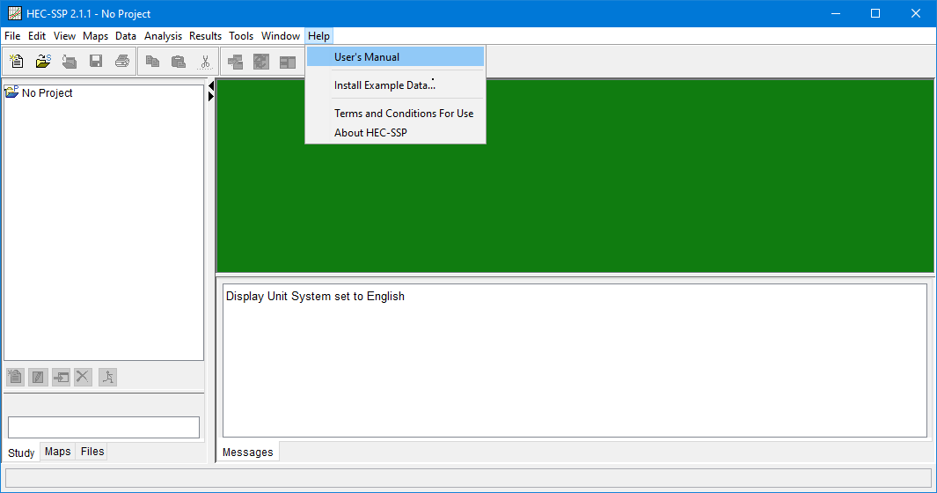
HecSSP
user manual:

Slide 17
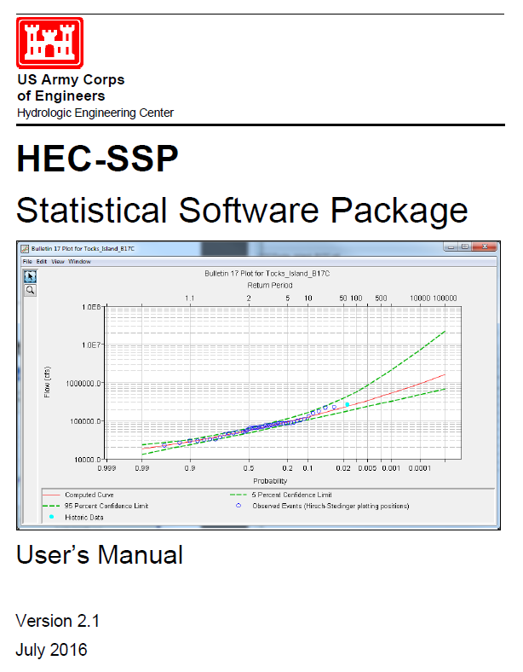

Slide 18
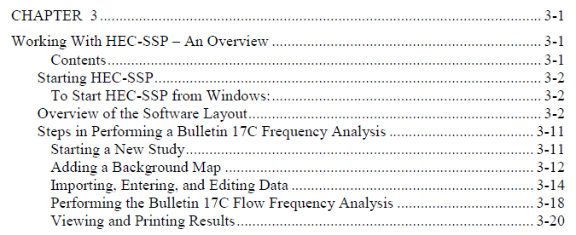
create a “Study”
create an “Analysis”

Slide 19
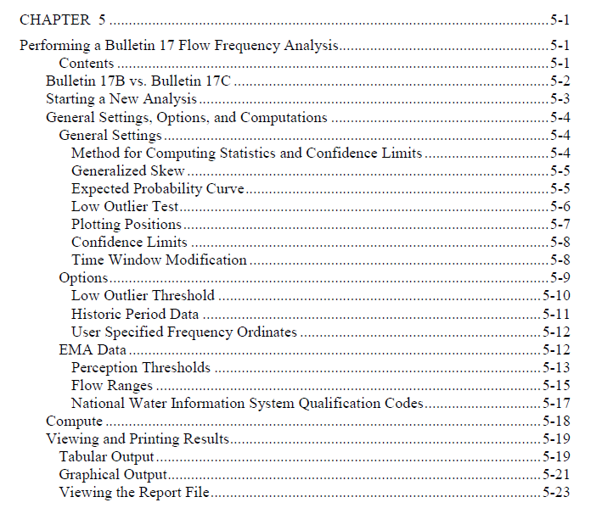
NOTE:
HecSSP has much better
documentation than PeakFQ!

Slide 20

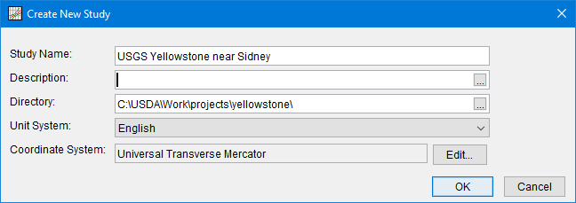
HecSSP
to start a Study:

Slide 21
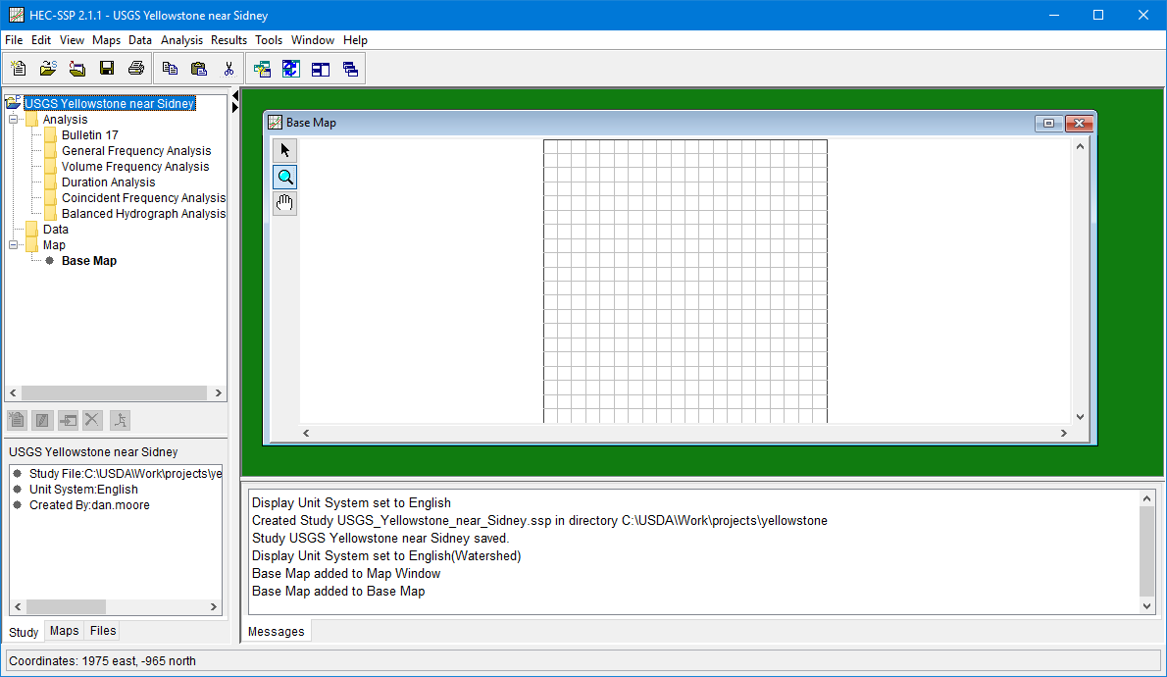
HecSSP
a Study has been started:
base map is optional
(not used in analysis)

Slide 22
HecSSP
a Study has been started:
SSP tells you what it is doing…

Slide 23
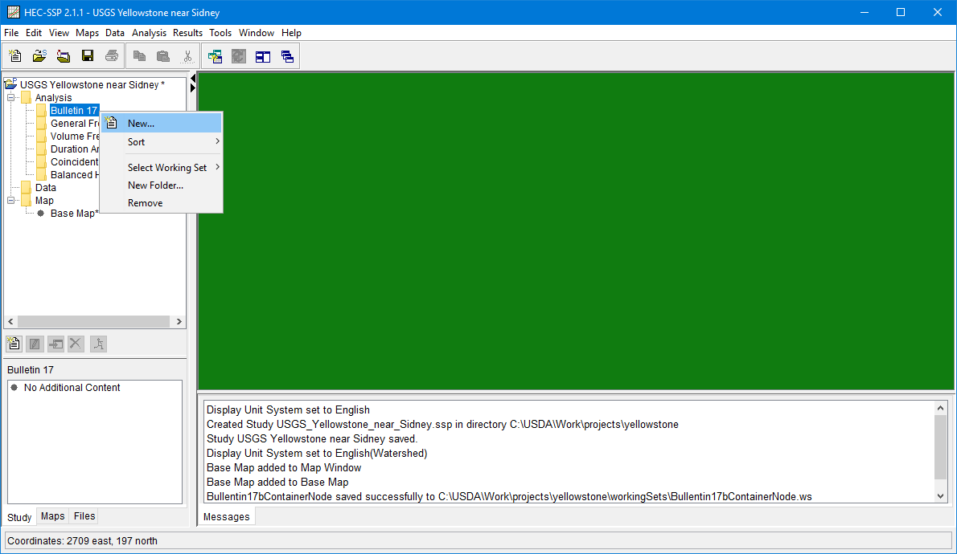
HecSSP
to run Bulletin 17 analysis:

Slide 24
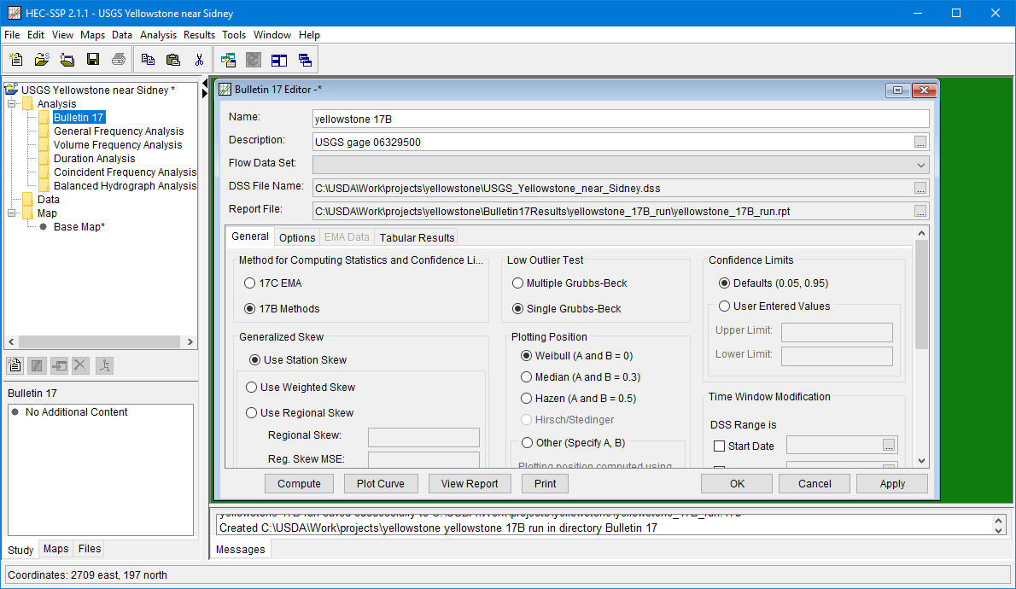
HecSSP
to run Bulletin 17 analysis:
create a name that matches
the options you pick

Slide 25
HecSSP
to run Bulletin 17 analysis:
but we need data!!!!

Slide 26
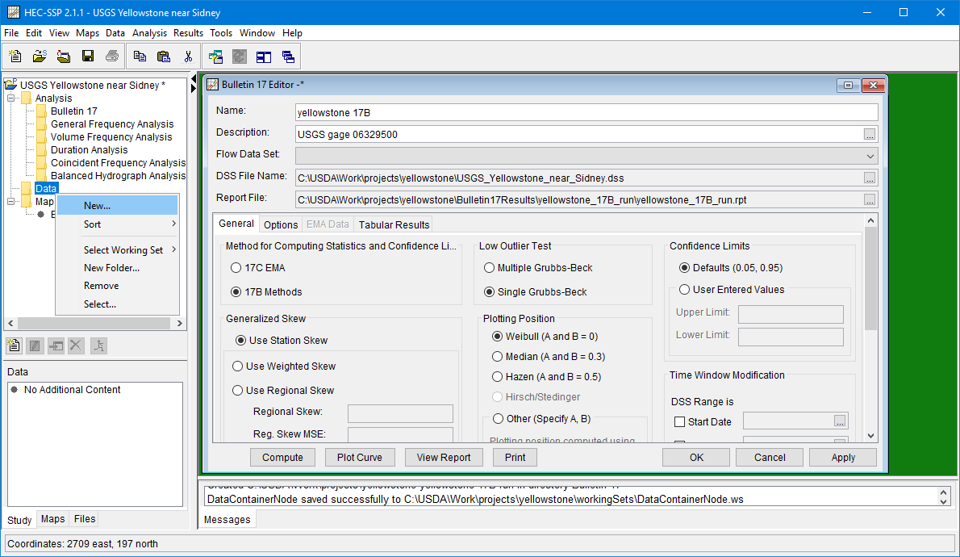
HecSSP
to run Bulletin 17 analysis:

Slide 27
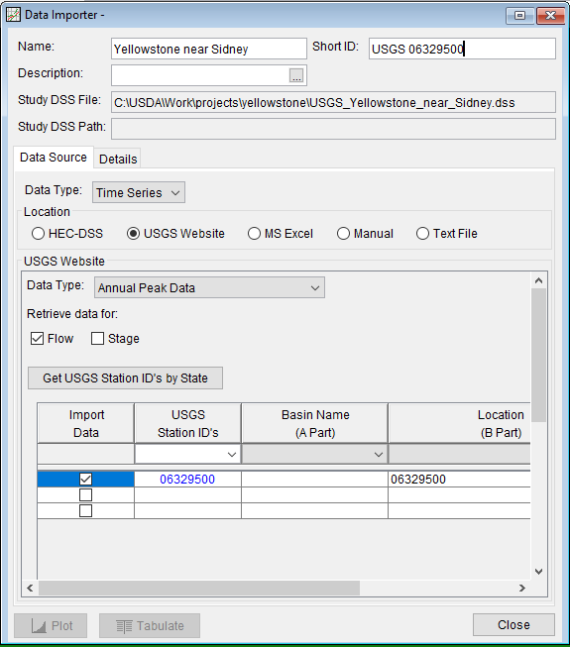
HecSSP
name the dataset
importing
peak data:
choose import type
specify gage ID
click:

Slide 28
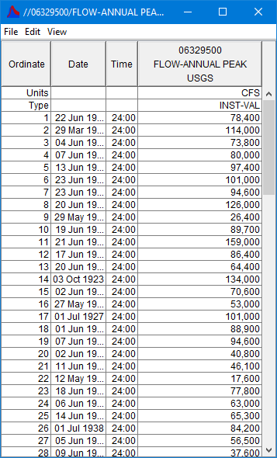
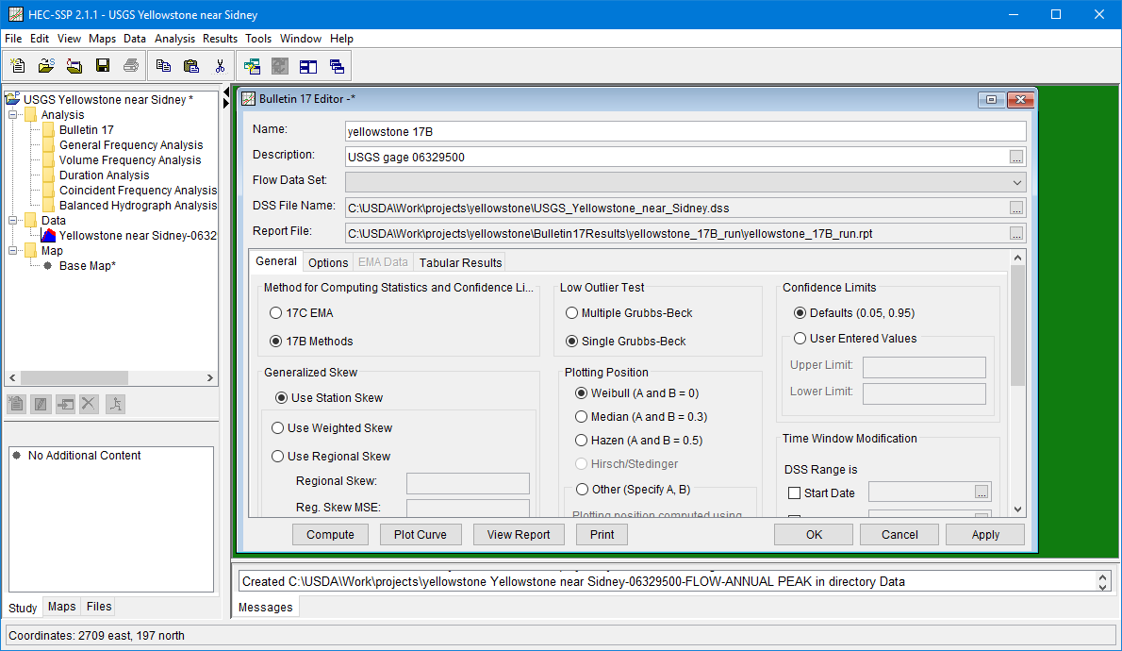
HecSSP
to run Bulletin 17 analysis:
data is now available
for our analysis
(right-click to see table)

Slide 29
HecSSP
to run Bulletin 17 analysis:
choose the data for
this particular analysis

Slide 30

HecSSP
to run Bulletin 17 analysis:
click Compute

Slide 31
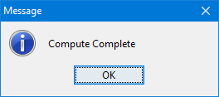
HecSSP
output options

Slide 32
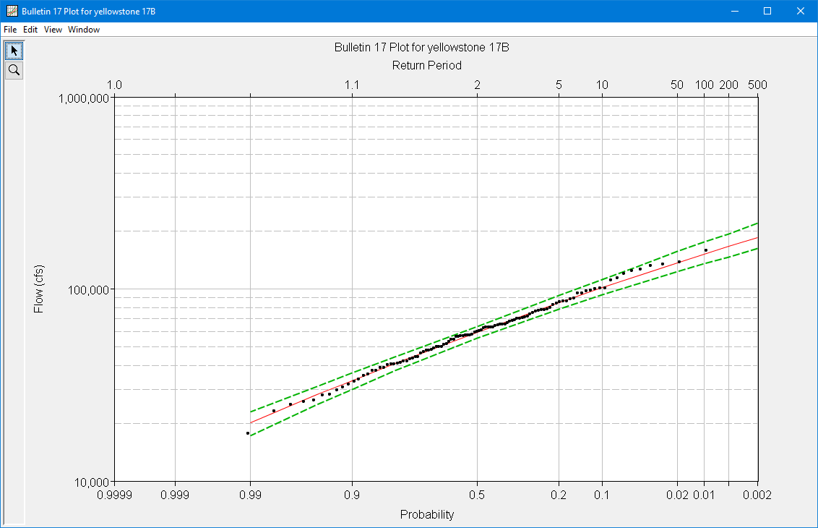
HecSSP
Bulletin 17B results:

Slide 33
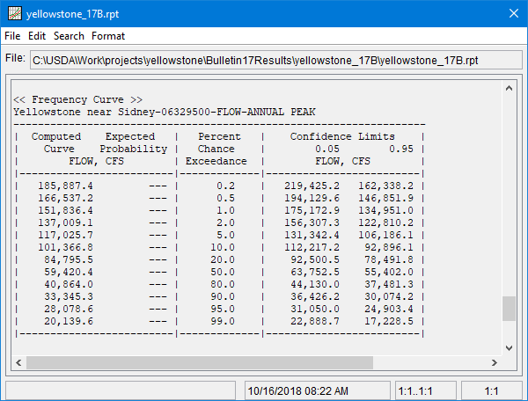
HecSSP
Bulletin 17B results:
text file
output
has *.rpt
extension

Slide 34
HecSSP
Bulletin 17B results:
You can
keep the
default
frequency
ordinates
or
choose
others…

Slide 35
HecSSP
Bulletin 17B results:
Options tab…

Slide 36
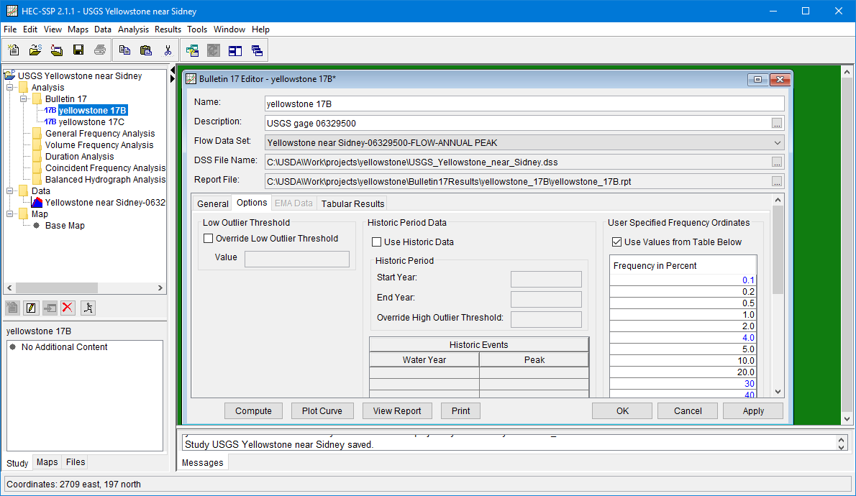
HecSSP
results options:
edit in your
preferences

Slide 37
HecSSP
to run Bulletin 17 EMA analysis:
That was the old way!
Let’s try 17C…

Slide 38
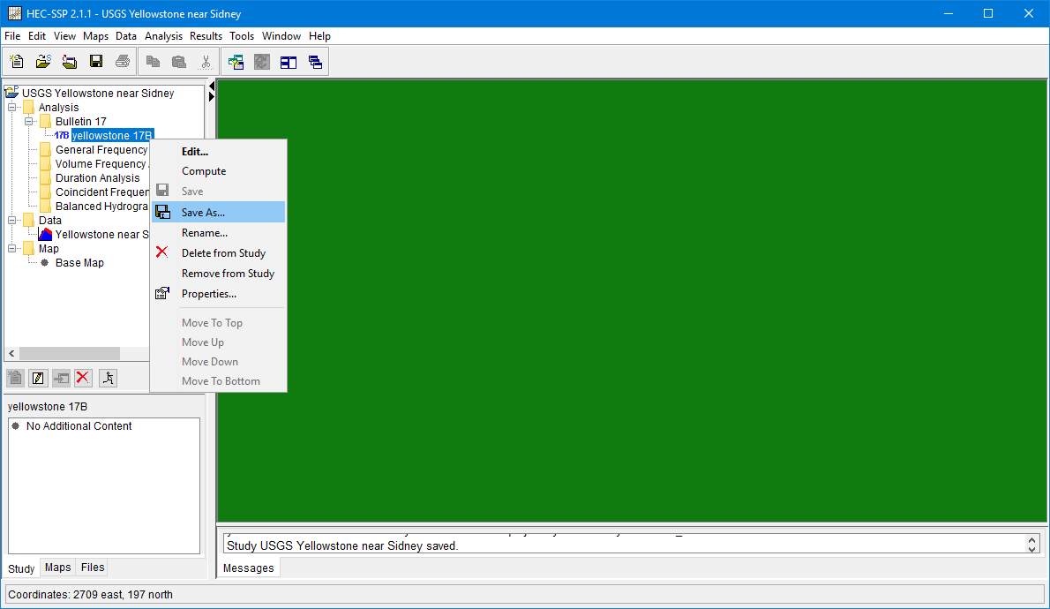
HecSSP
to run Bulletin 17 EMA analysis:
save & close the 1st analysis
2) start a new one from scratch, or
3) save a copy and edit

Slide 39
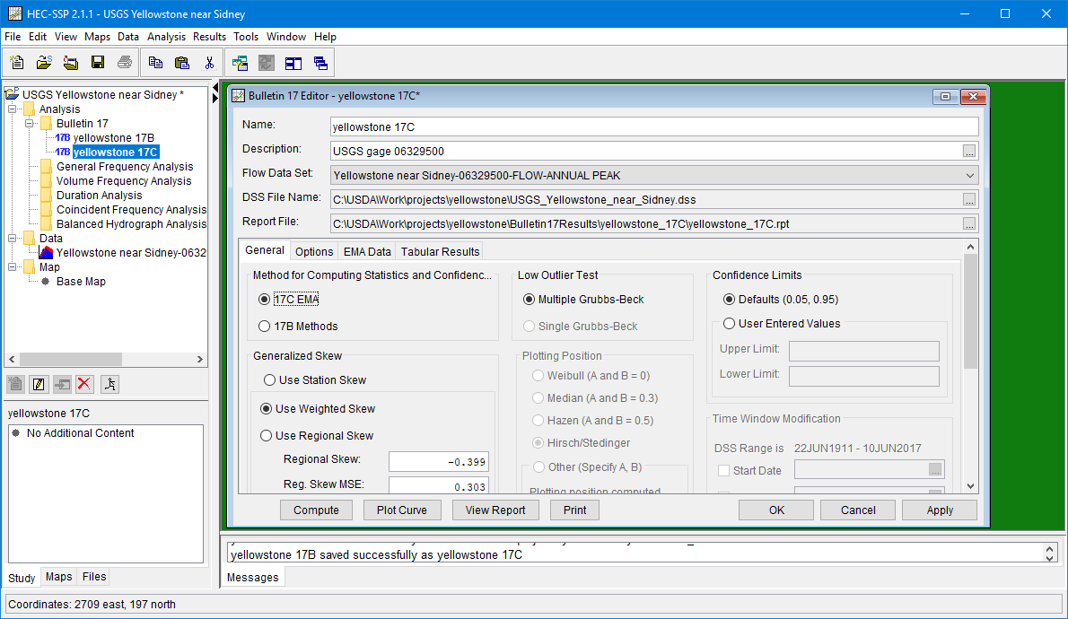
HecSSP
to run Bulletin 17 EMA analysis:
analysis named for its type
click the other radio button

Slide 40
HecSSP
to run Bulletin 17 EMA analysis:
EMA requires more info
if gage data has missing years
or historic ungaged floods exist

Slide 41
HecSSP
to run Bulletin 17 EMA analysis:
if you just click Compute without
paying attention to the
EMA tab…

Slide 42
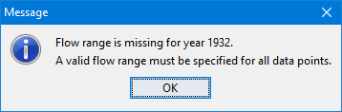
HecSSP
to run Bulletin 17 EMA analysis:
It won’t run if the data
has missing years!

Slide 43
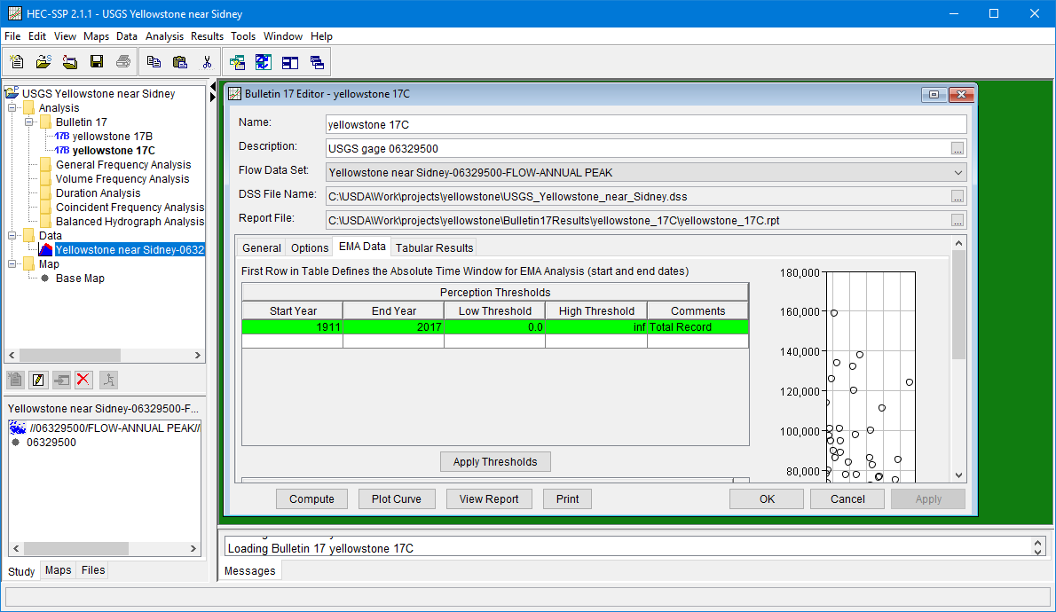
HecSSP
EMA particulars
scroll down

Slide 44
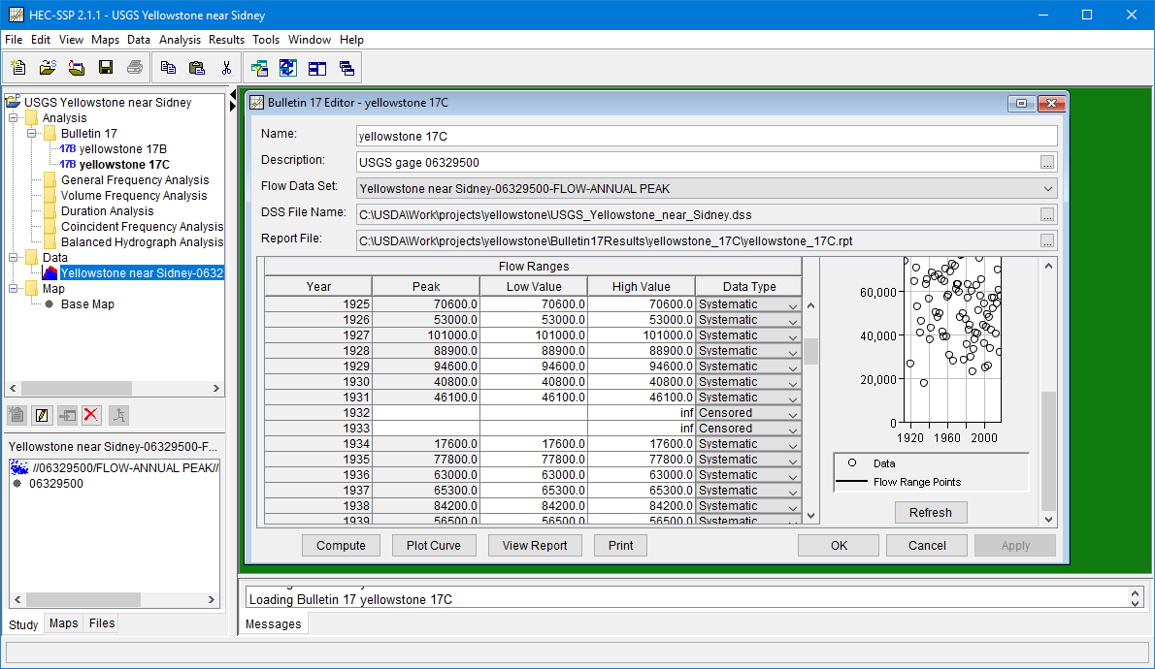
HecSSP
EMA particulars
missing years, but…

Slide 45
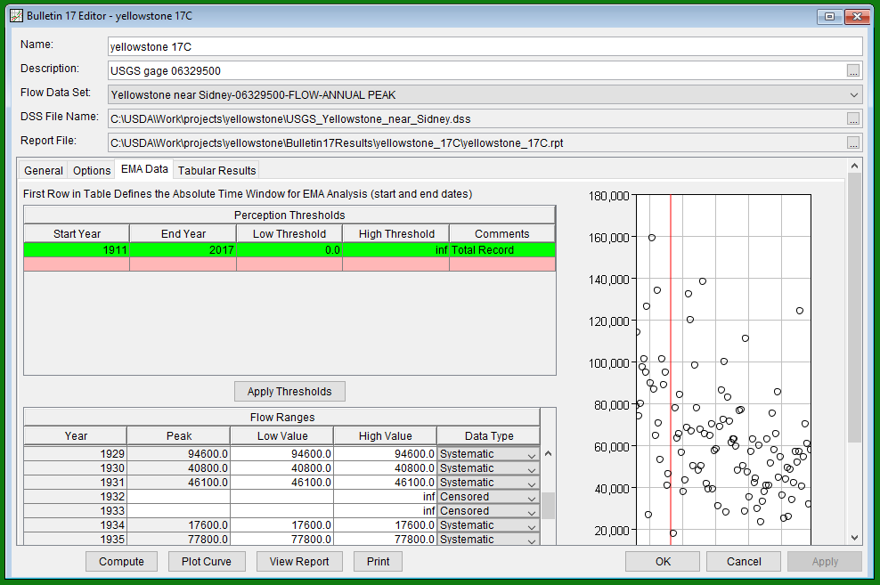
HecSSP
…scroll back up and handle the
missing years in the table of
“Perception Thresholds”

Slide 46
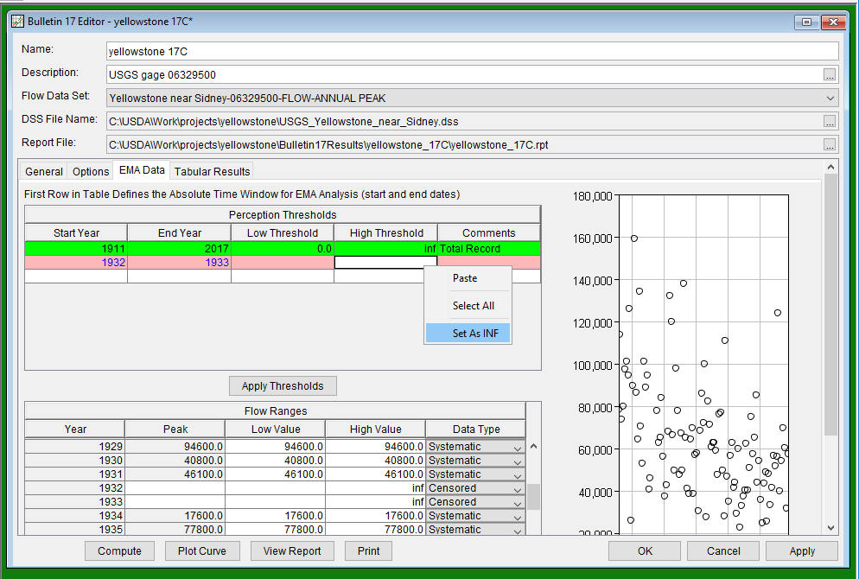
HecSSP
insert year range, and set both high & low
threshold to “inf” (indicating no knowledge)

Slide 47
HecSSP
this option becomes avavailable by
double-clicking the cell, then right-clicking.

Slide 48
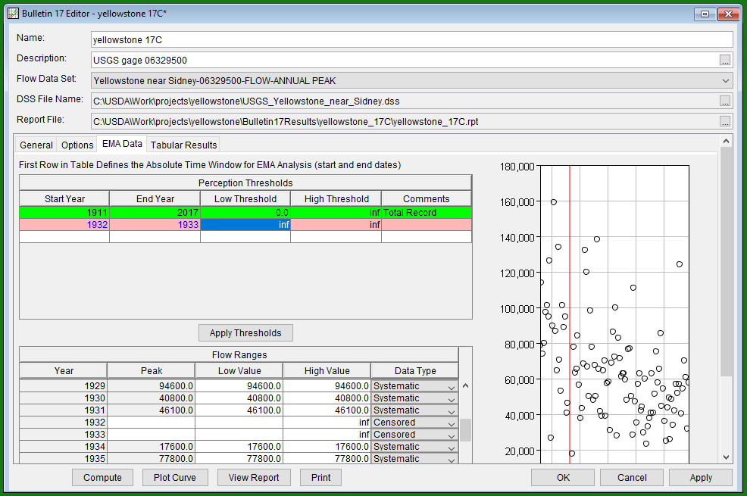
HecSSP
click this button to fill in
the fill in the table values

Slide 49
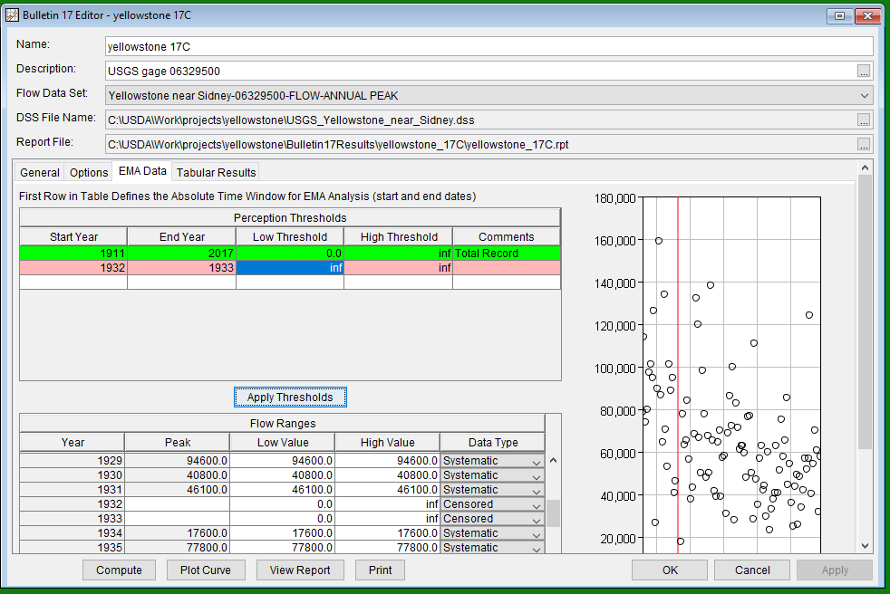
HecSSP
try another run…

Slide 50
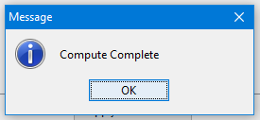
HecSSP

Slide 51
HecSSP
suppose our dataset
has historic floods
as well as missing years?

Slide 52
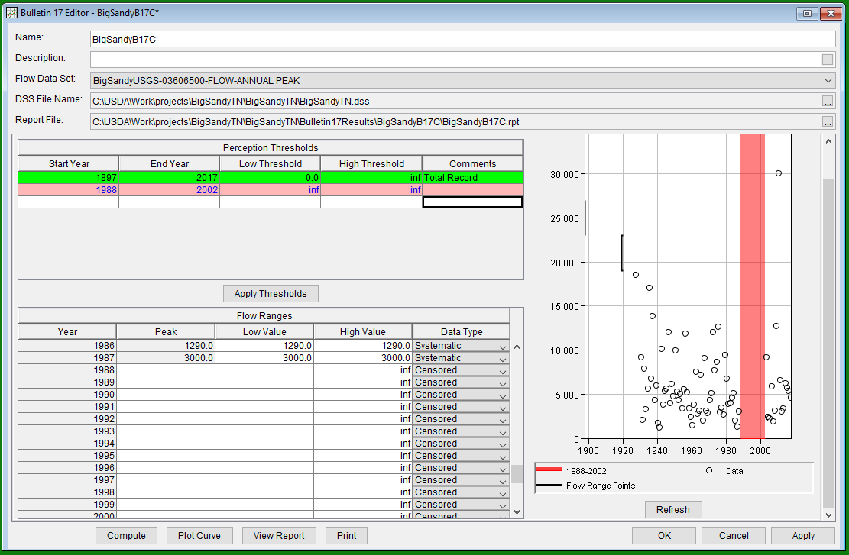
HecSSP
different station! (used in Appendix 6, Bulletin 17B)
Leave the first row as is, and
use following rows to supercede
some of the record of the 1st row.

Slide 53
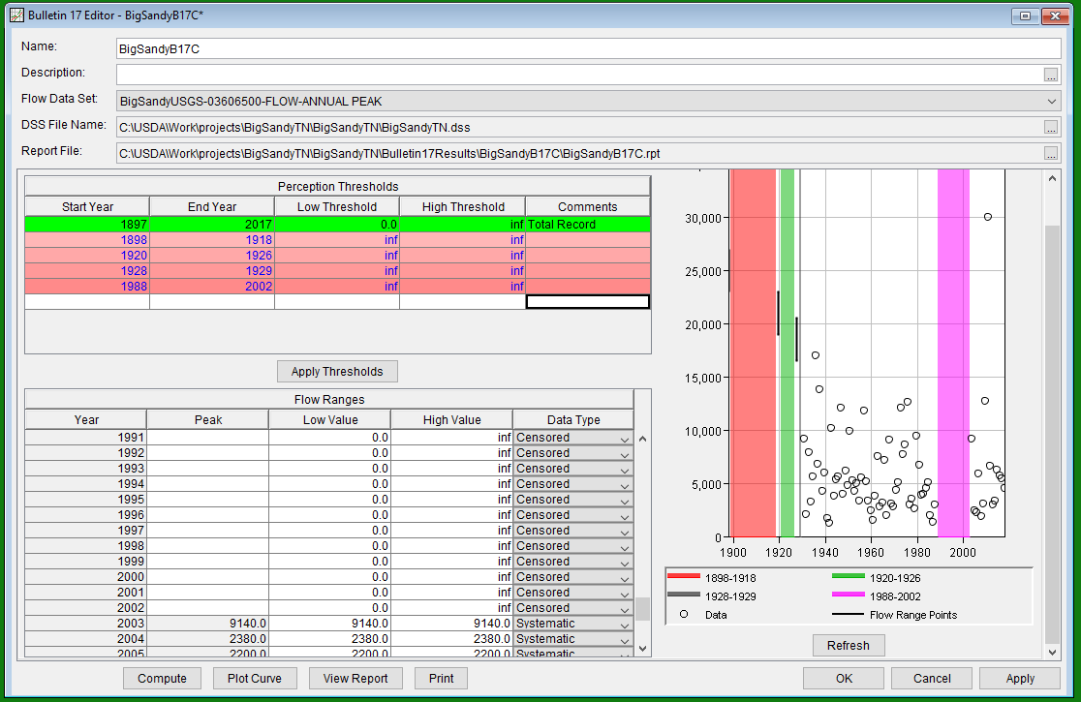
HecSSP
Do all the periods of missing data,
then click Apply Thresholds to
set flow ranges.

Slide 54
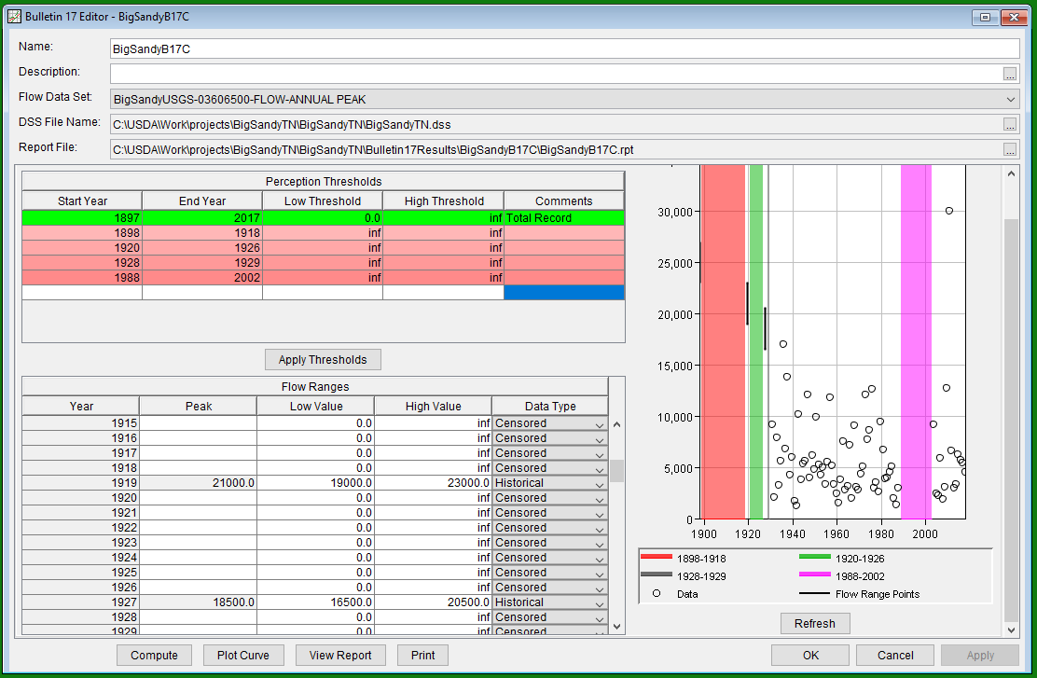
HecSSP
This does not work for
setting historic years…
edit directly
in the table

Slide 55
HecSSP
Save and then Compute!

Slide 56
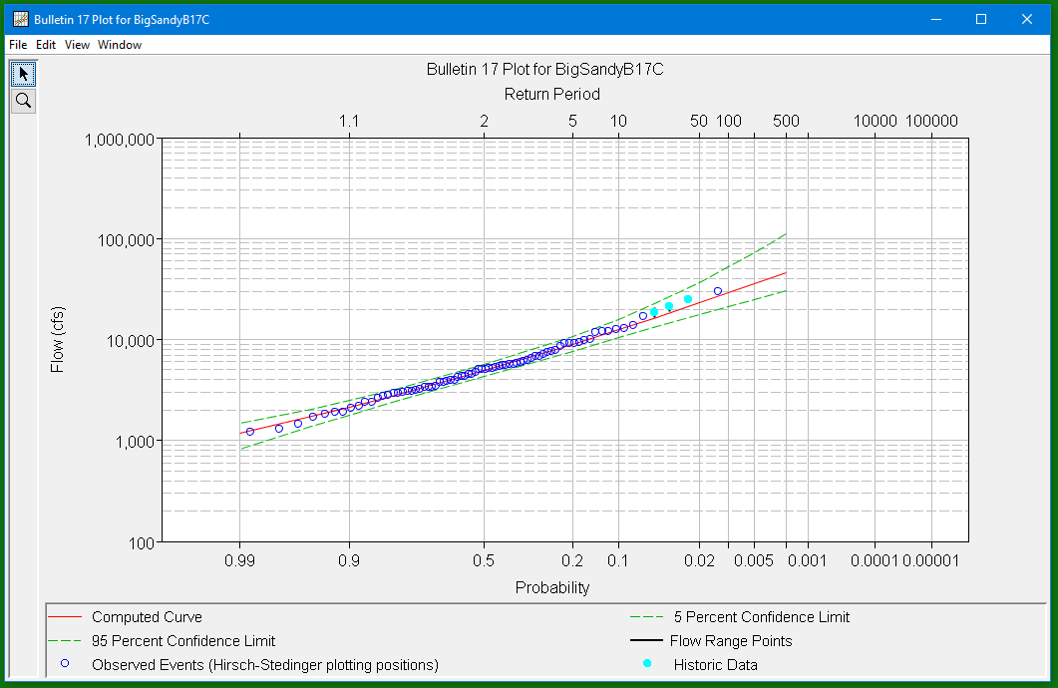
HecSSP
Bulletin 17C EMA analysis results!

Slide 57

changing horses midstream…
Let’s look at how PeakFQ works.

Slide 58
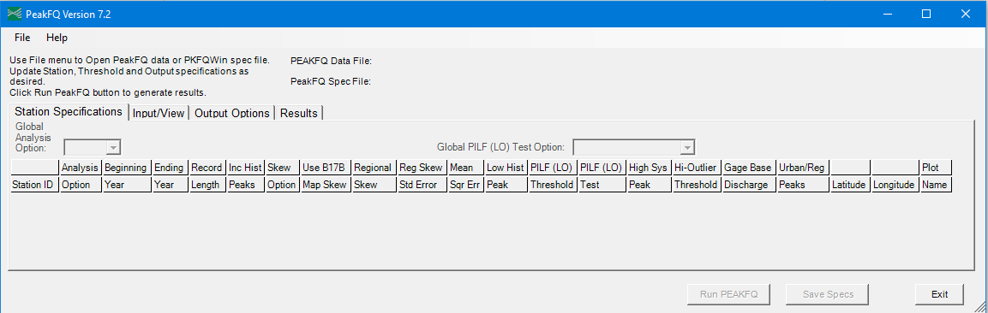
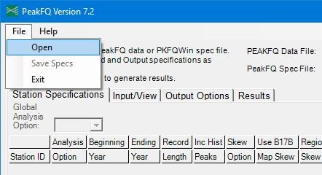
PeakFQ
program main menu:
first, it wants you to
open a peak flow dataset

Slide 59
USGS streamflow
The annual peak data must be obtained
outside of PeakFQ, such as from the web.

Slide 60
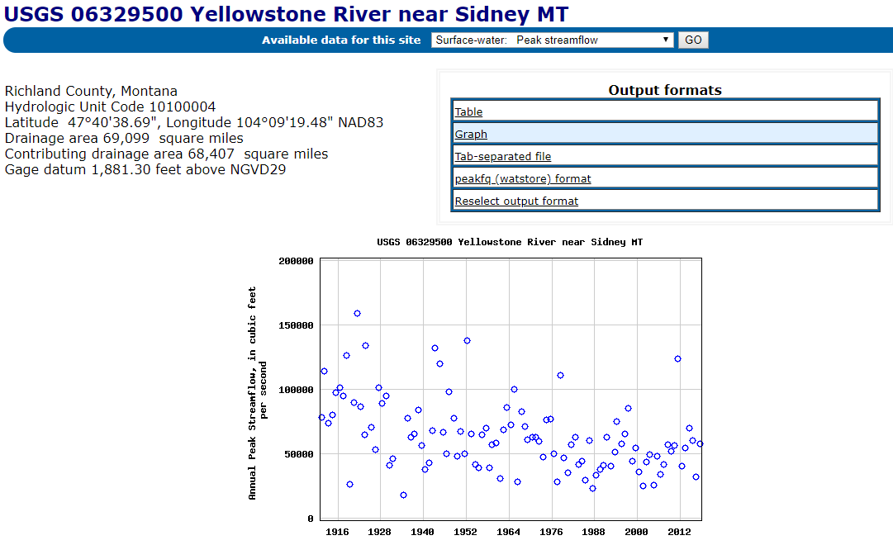
USGS streamflow
save this
text file

Slide 61
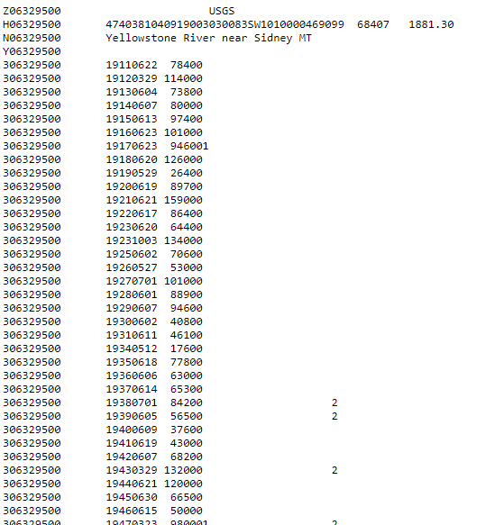
USGS streamflow
gage #
peak
flow
text file
date

Slide 62
PeakFQ
program main menu:
open the saved peak flow file

Slide 63
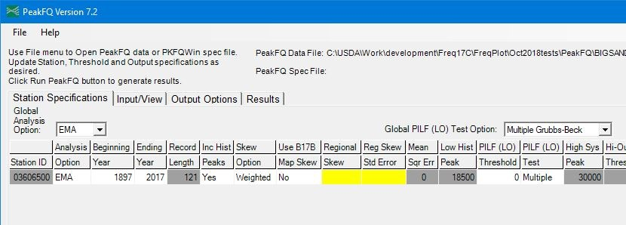
PeakFQ
program main menu:
EMA is default option

Slide 64
PeakFQ
program main menu:
weighted skew is also default,
requiring skew input (or…)

Slide 65
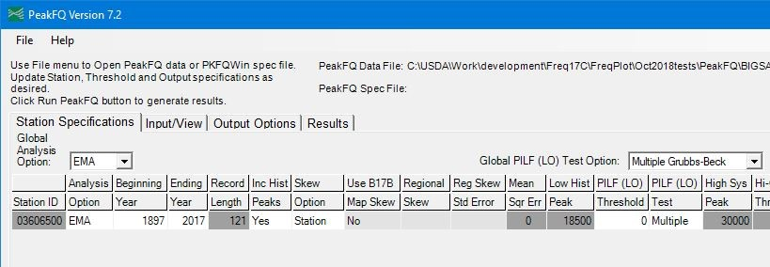
PeakFQ
program main menu:
…switch to station skew

Slide 66
PeakFQ
input tab
next, check the input list

Slide 67
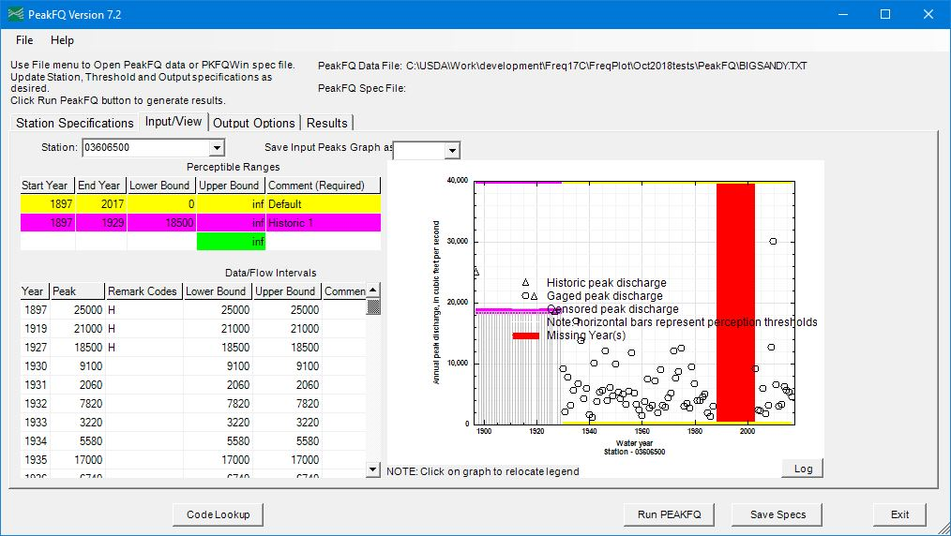
PeakFQ
3 historic years
(these happen to
have been added
by USGS to the
gaged record
and flagged)
You can add
historic floods
obtained by
other means!

Slide 68
PeakFQ
missing year periods

Slide 69
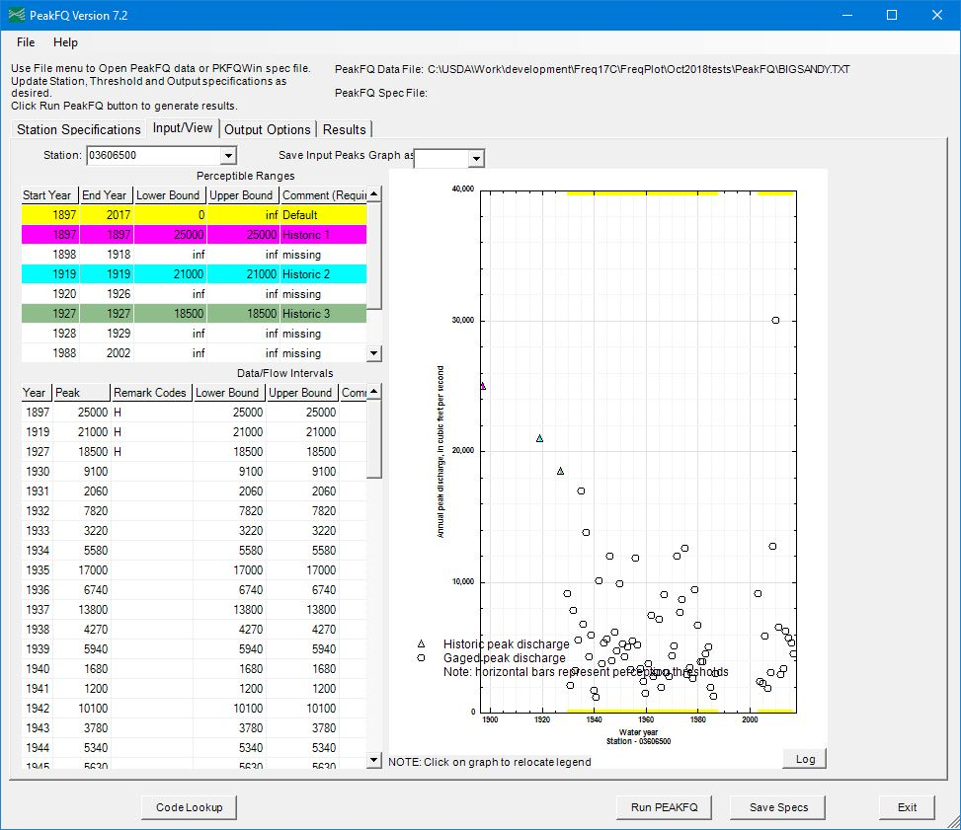
fill in dates,
thresholds,
and comments

Slide 70
then run it!

Slide 71
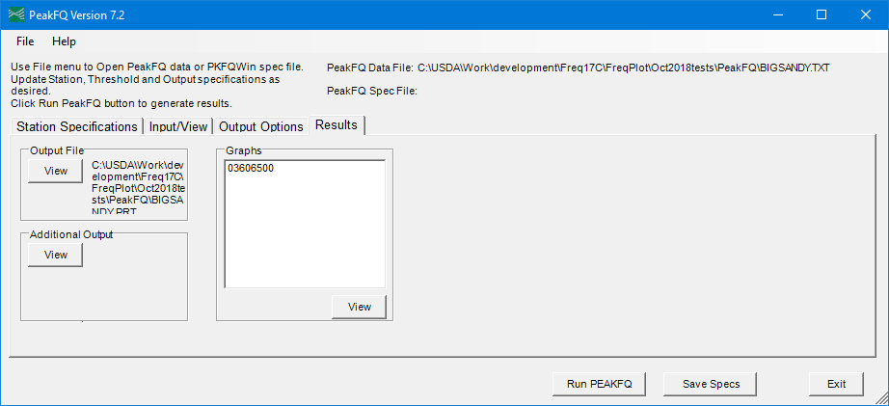
PeakFQ
Results tab…

Slide 72
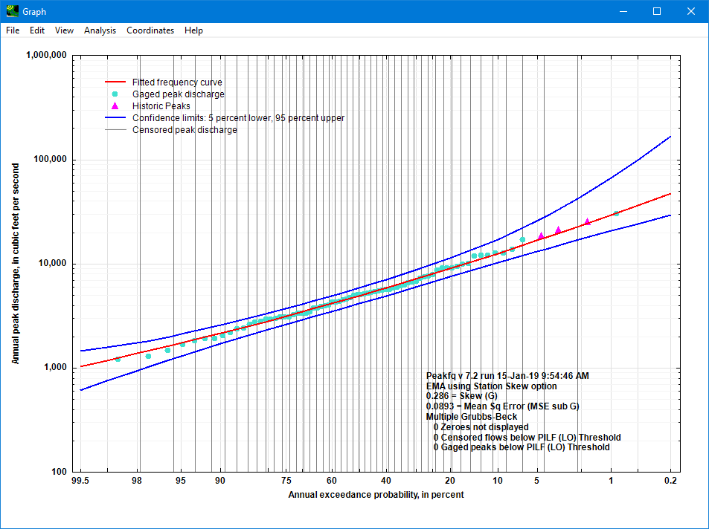
PeakFQ

Slide 73

One more thing!?

Slide 74
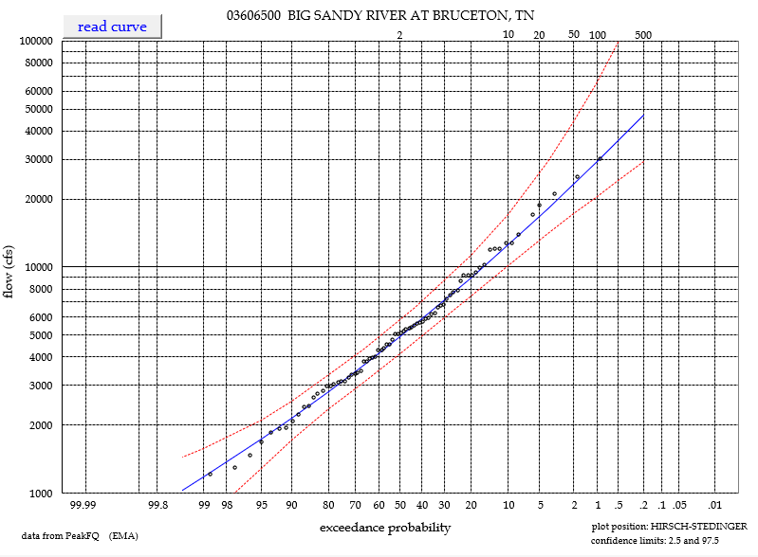
excel: FreqPlot
This is only to create
good looking plots
from the output of
the other programs.
You also have more control over
the scale, fonts, colors, etc.

Slide 75
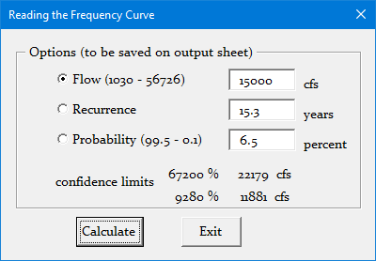
excel: FreqPlot
The spreadsheet can also
read the curve for you!

Slide 76
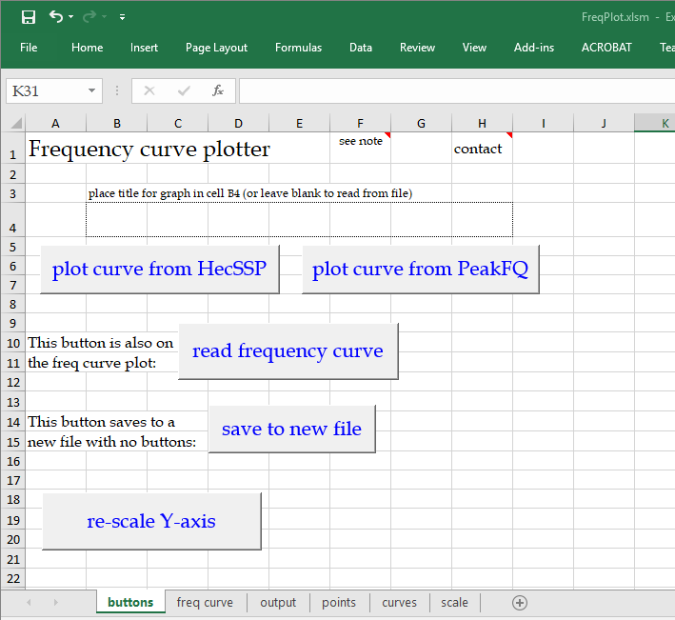
buttons give
you options

Slide 77
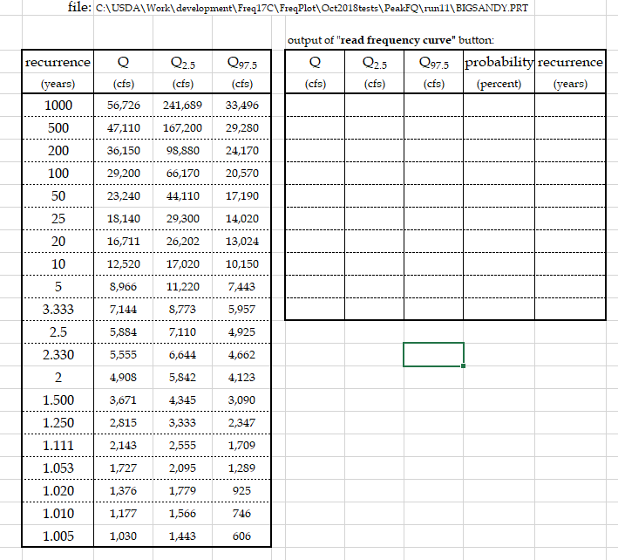
excel: FreqPlot
tabular data
also available

Slide 78
excel: FreqPlot
FreqPlot.xlsm is available with this webinar
or downloadable from:
https://go.usa.gov/xEDj8

Slide 79
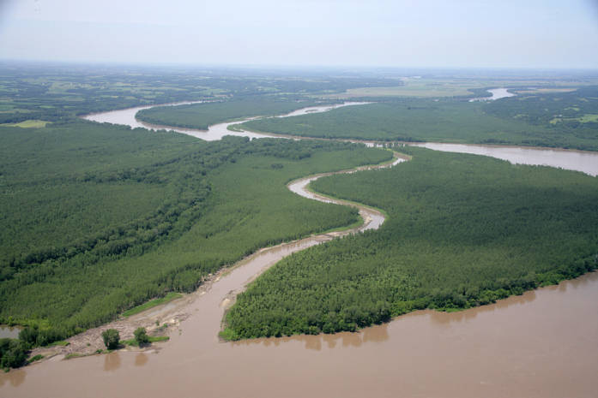
Maybe that’s
Enough meandering!

